Slide 1
CSE / T / 423C Distributed Computing Topic 11: Hadoop, MapReduce and Spark
Sarbani Roy
Department of Computer Science & Engineering
Jadavpur University
E-mail: sarbani.roy@jadavpuruniversity.in
Room: CC-5-7
Phone: 9051639328

Slide 2
Requirements of Data Science Applications
Example Applications: Recommendations, Recognition, Targeted Advertising, Monitoring etc.
Big Data: volume, velocity, variety, veracity
Storage and Computation
Platforms for Processing, Programming, Visualization, Libraries
Hadoop is an open-source software framework that provides for processing of large data sets across clusters of computers using simple programming models.

Slide 3
Apache Hadoop
The Apache Hadoop project develops open-source software for reliable, scalable, distributed computing.
The Apache Hadoop software library is a framework that allows for the distributed processing of large data sets across clusters of computers using simple programming models.
It is designed to scale up from single servers to thousands of machines, each offering local computation and storage.
Rather than rely on hardware to deliver high-availability, the library itself is designed to detect and handle failures at the application layer, so delivering a highly-available service on top of a cluster of computers, each of which may be prone to failures.

Slide 4
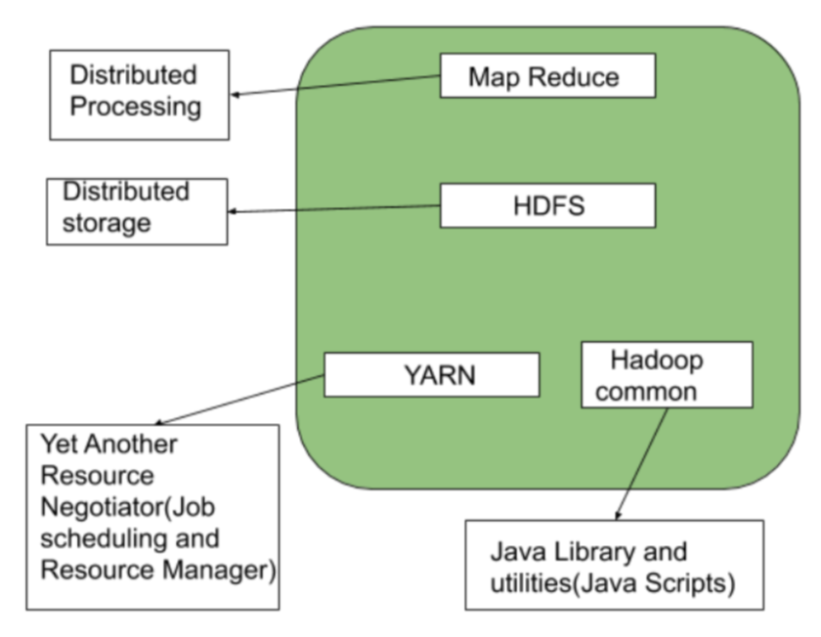
Main Modules
Hadoop Common: The common utilities that support the other Hadoop modules.
Hadoop Distributed File System (HDFS): A distributed file system that provides high-throughput access to application data.
Hadoop YARN: A framework for job scheduling and cluster resource management.
Hadoop MapReduce: A YARN-based system for parallel processing of large data sets.
Hadoop Ozone: An object store for Hadoop.

Slide 5
Related Projects
Ambari: A web-based tool for provisioning, managing, and monitoring Apache Hadoop clusters which includes support for Hadoop HDFS, Hadoop MapReduce, Hive, HBase, ZooKeeper, Pig and Sqoop etc.
Ambari also provides a dashboard for viewing cluster health such as heatmaps and ability to view MapReduce, Pig and Hive applications visually along with features to diagnose their performance characteristics in a user-friendly manner.
Avro: A data serialization system.
Data serialization is the process of converting data objects present in complex data structures into a byte stream for storage, transfer and distribution purposes on physical devices.
Cassendra: A scalable multi-master NoSQL database with no single points of failure.
Chukwa: A data collection system for managing large distributed systems.
HBase: A scalable, distributed, NoSQL database that supports structured data storage for large tables.
Hive: A data warehouse infrastructure that provides data summarization and adhoc querying.
Pig: A high-level data-flow language and execution framework for parallel computation.
ZooKeeper: A high-performance coordination service for distributed applications.
Sqoop: is used for loading data from relational databases into HDFS
Flume: is used to capture a stream of moving data

Slide 6
Related Projects – Data processing
Mahout: A Scalable machine learning and data mining library.
Spark: A fast and general compute engine for Hadoop data. Spark provides a simple and expressive programming model that supports a wide range of applications, including ETL (extract, transform and load), machine learning, stream processing, and graph computation.
Submarine: A unified AI platform which allows engineers and data scientists to run Machine Learning and Deep Learning workload in distributed cluster.

Slide 7
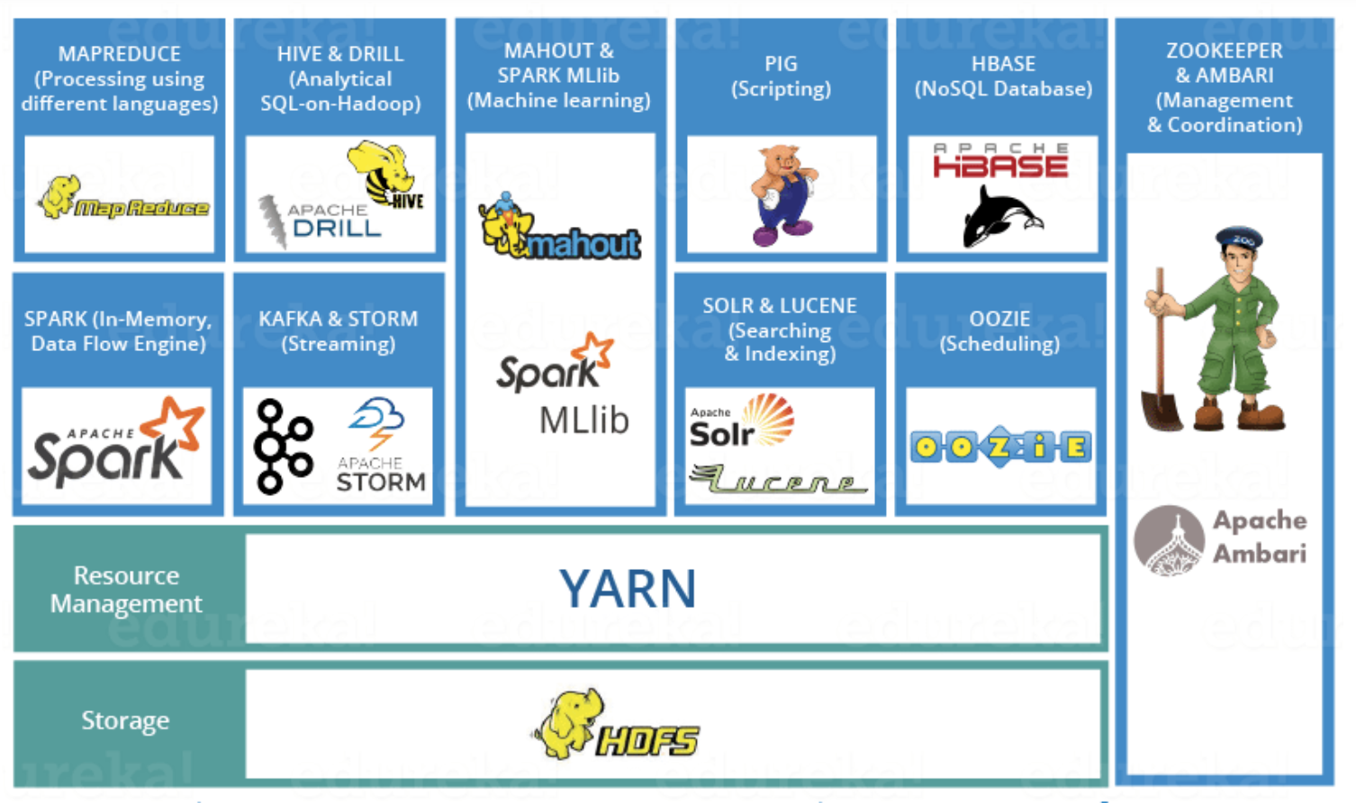
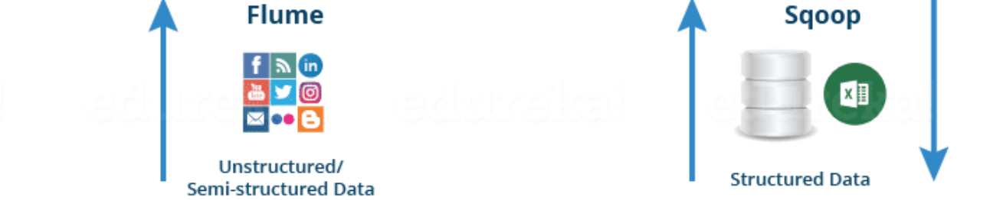
Hadoop Ecosystem

Slide 8
Advantages of Hadoop
Hadoop framework allows the user to quickly write and test distributed systems. It is efficient, and it automatic distributes the data and work across the machines and in turn, utilizes the underlying parallelism of the CPU cores.
Hadoop does not rely on hardware to provide fault-tolerance and high availability (FTHA), rather Hadoop library itself has been designed to detect and handle failures at the application layer.
Servers can be added or removed from the cluster dynamically and Hadoop continues to operate without interruption.
Another big advantage of Hadoop is that apart from being open source, it is compatible on all the platforms since it is Java based.

Slide 9
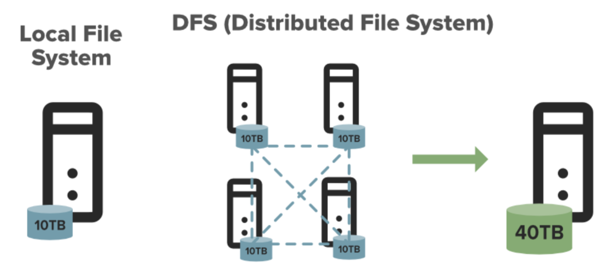
Distributed File System
DFS stands for the distributed file system, it is a concept of storing the file in multiple nodes in a distributed manner. DFS actually provides the abstraction for a single large system whose storage is equal to the sum of storage of other nodes in a cluster.

Slide 10
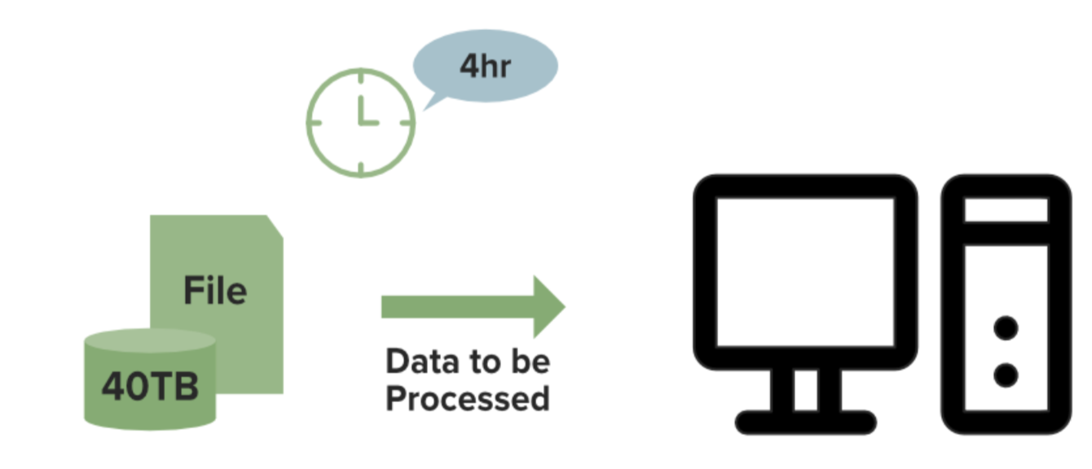
Local File System Processing
Time Consuming !!!

Slide 11
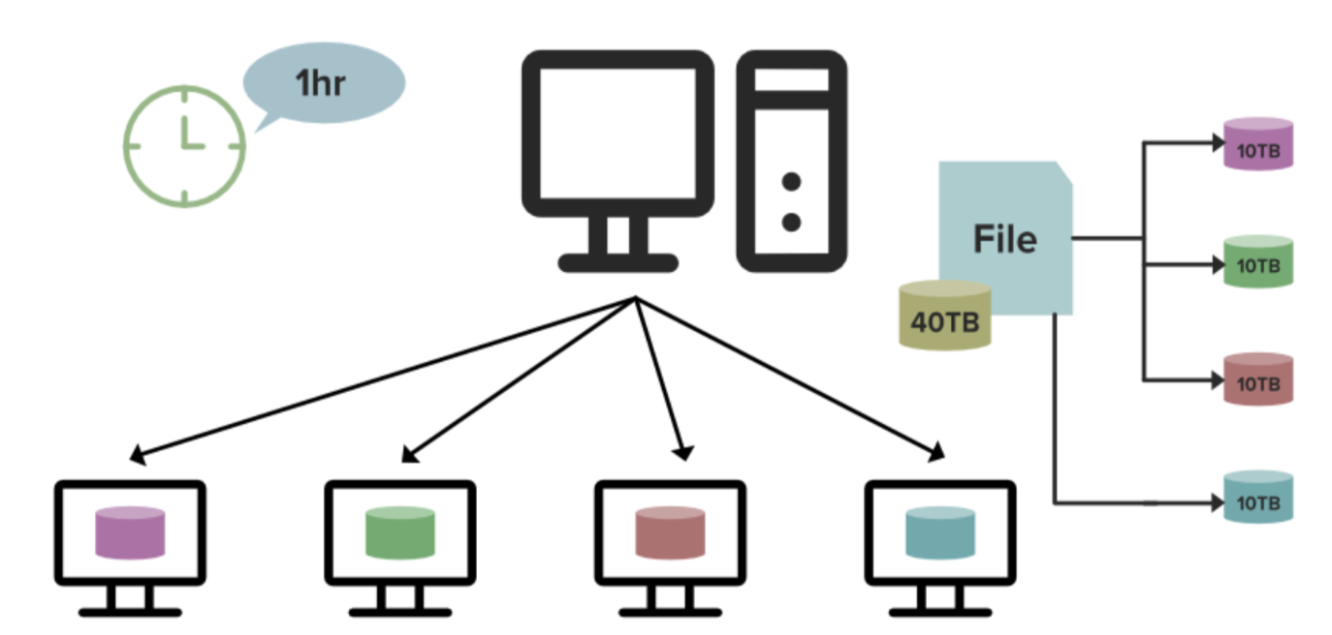
DFS Processing
Fast Processing !!!

Slide 12
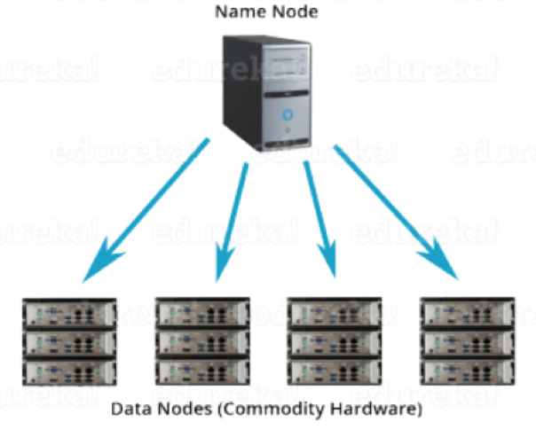
HDFS(Hadoop Distributed File System)
Responsible for storing data on the cluster
Data files are split into blocks and distributed across the nodes in the cluster
Each block is replicated multiple times
HDFS is a file system written in Java based on the Google’s File System (GFS)
Provides redundant storage for massive amounts of data

Slide 13
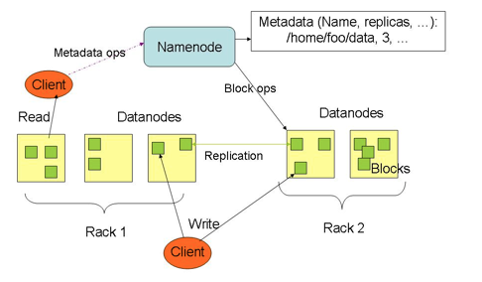
HDFS – Master/Slave Architecture
NameNode: a master server that manages the file system namespace and regulates access to files by clients.
DataNodes: usually one per node in the cluster, which manage storage attached to the nodes that they run on.
Notes:
HDFS has a master/slave architecture. An HDFS cluster consists of a single NameNode, a master server that manages the file system namespace and regulates access to files by clients. In addition, there are a number of DataNodes, usually one per node in the cluster, which manage storage attached to the nodes that they run on. HDFS exposes a file system namespace and allows user data to be stored in files. Internally, a file is split into one or more blocks and these blocks are stored in a set of DataNodes. The NameNode executes file system namespace operations like opening, closing, and renaming files and directories. It also determines the mapping of blocks to DataNodes. The DataNodes are responsible for serving read and write requests from the file system’s clients. The DataNodes also perform block creation, deletion, and replication upon instruction from the NameNode.

Slide 14
How are Files Stored
The NameNode keeps track of which blocks make up a file and where they are stored
Files are split into blocks
Blocks are split across many machines at load time.
Different blocks from the same file will be stored on different machines
Blocks are replicated across multiple machines
Notes:
Default replication is 3-fold

Slide 15
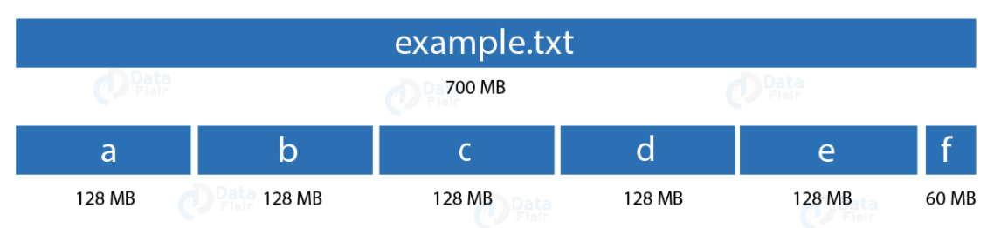
Block Size
HDFS is designed to reliably store very large files across machines in a large cluster. It stores each file as a sequence of blocks; all blocks in a file except the last block are the same size. Default block size is 64 MB to 128 MB

Slide 16
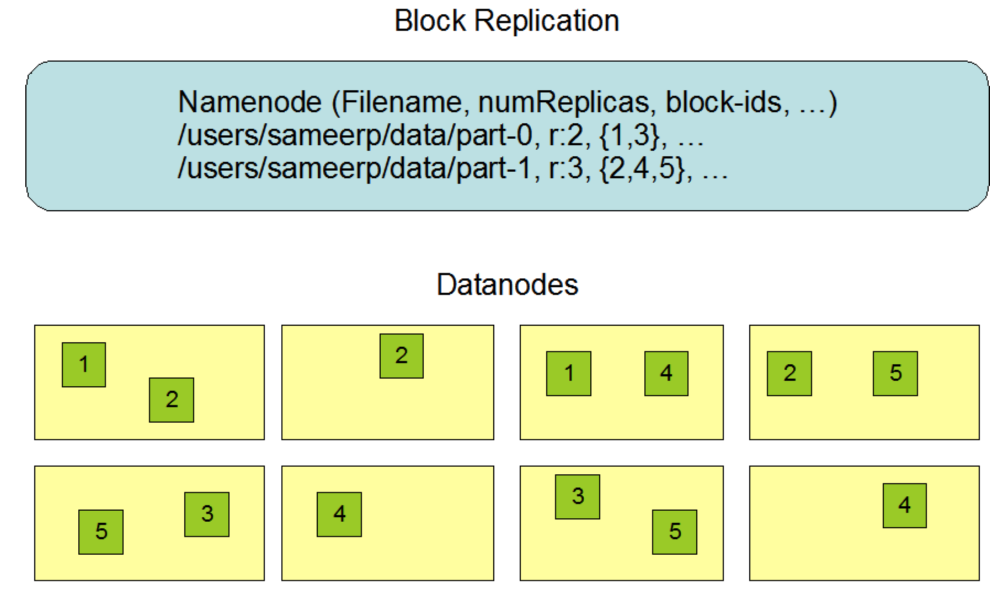
Data Replication
The blocks of a file are replicated for fault tolerance.
The block size and replication factor are configurable per file.
An application can specify the number of replicas of a file.
The replication factor can be specified at file creation time and can be changed later.
Files in HDFS are write-once and have strictly one writer at any time

Slide 17
Data Retrieval- When a client wants to retrieve data
Communicates with the NameNode to determine which blocks make up a file and on which data nodes those blocks are stored
Then communicated directly with the data nodes to read the data

Slide 18
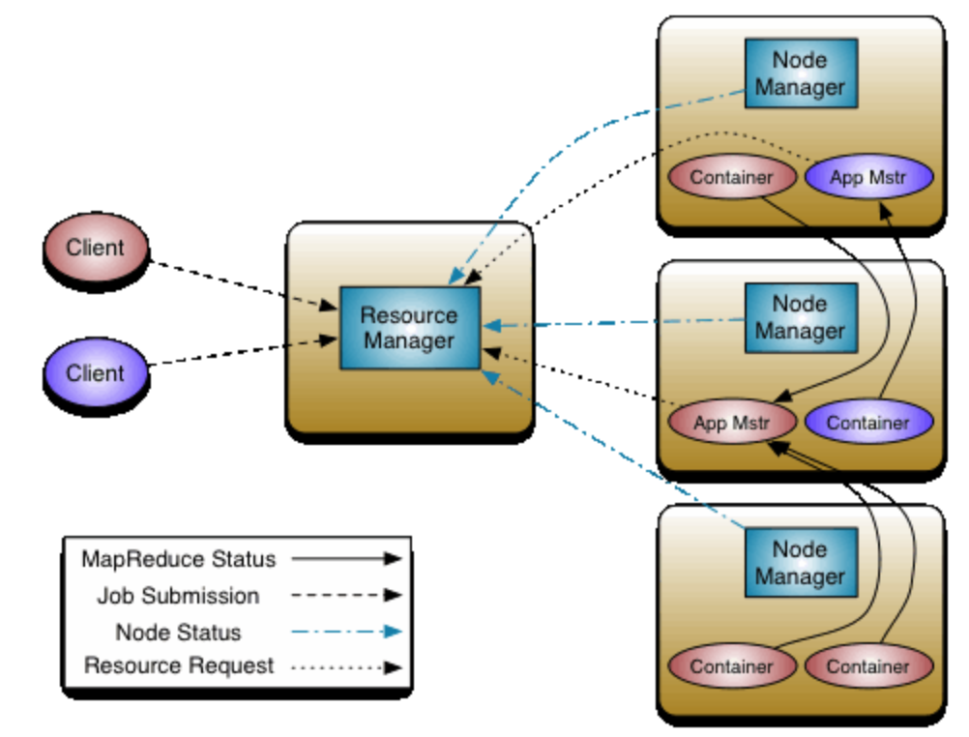
YARN
The fundamental idea of YARN is to split up the functionalities of resource management and job scheduling/monitoring into separate daemons.
Global ResourceManager (RM) and
Per-application an ApplicationMaster (AM).
An application is either a single job or a DAG of jobs.

Slide 19
YARN
The NodeManager is the per-machine framework agent who is responsible for containers, monitoring their resource usage (cpu, memory, disk, network) and reporting the same to the ResourceManager/Scheduler.
The ResourceManager is the ultimate authority that arbitrates resources among all the applications in the system.
The per-application ApplicationMaster is, in effect, a framework specific library and is tasked with negotiating resources from the ResourceManager and working with the NodeManager(s) to execute and monitor the tasks.

Slide 20
YARN
Client submits an application
The Resource Manager allocates a container to start the Application Manager
The Application Manager registers itself with the Resource Manager
The Application Manager negotiates containers from the Resource Manager
The Application Manager notifies the Node Manager to launch containers
Application code is executed in the container
Client contacts Resource Manager/Application Manager to monitor application’s status
Once the processing is complete, the Application Manager un-registers with the Resource Manager

Slide 21
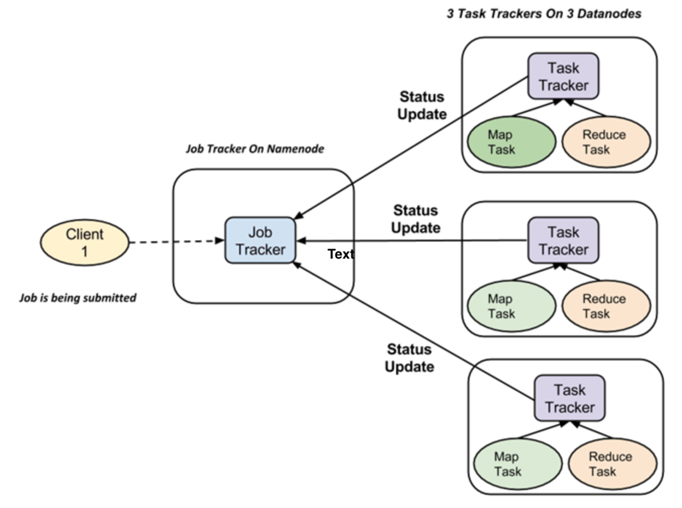
MapReduce
Two types of tasks:
Map tasks (Splits & Mapping)
Reduce tasks (Shuffling, Reducing)
The complete execution process (execution of Map and Reduce tasks, both) is controlled by two types of entities:
Jobtracker: Acts like a master (responsible for complete execution of submitted job)
Multiple Task Trackers: Acts like slaves, each of them performing the job

Slide 22
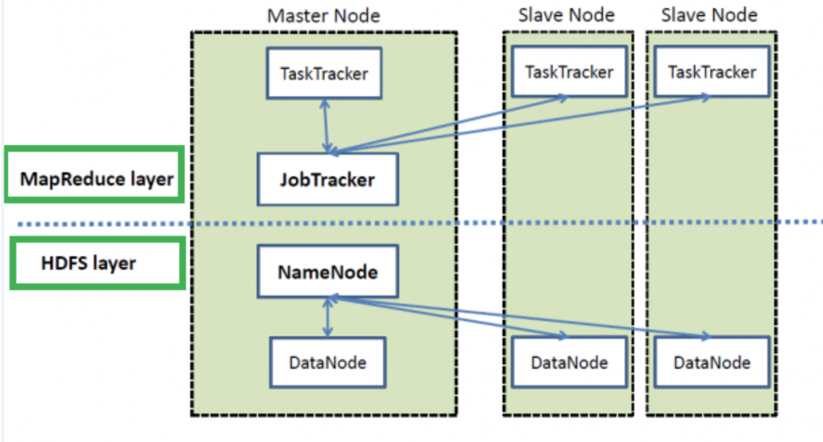
MapReduce
High Level Architecture

Slide 23
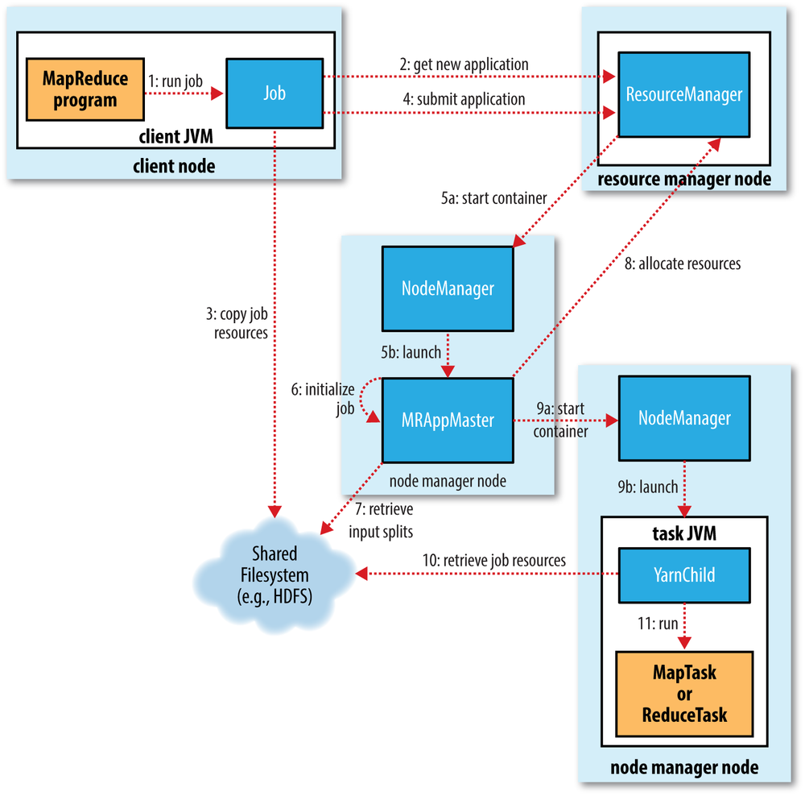
MapReduce
The client, which submits the MapReduce job.
The YARN resource manager, which coordinates the allocation of compute resources on the cluster.
The YARN node managers, which launch and monitor the compute containers on machines in the cluster.
The MapReduce application master, which coordinates the tasks running the MapReduce job. The application master and the MapReduce tasks run in containers that are scheduled by the resource manager and managed by the node managers.
The distributed filesystem (normally HDFS), which is used for sharing job files between the other entities.

Slide 24
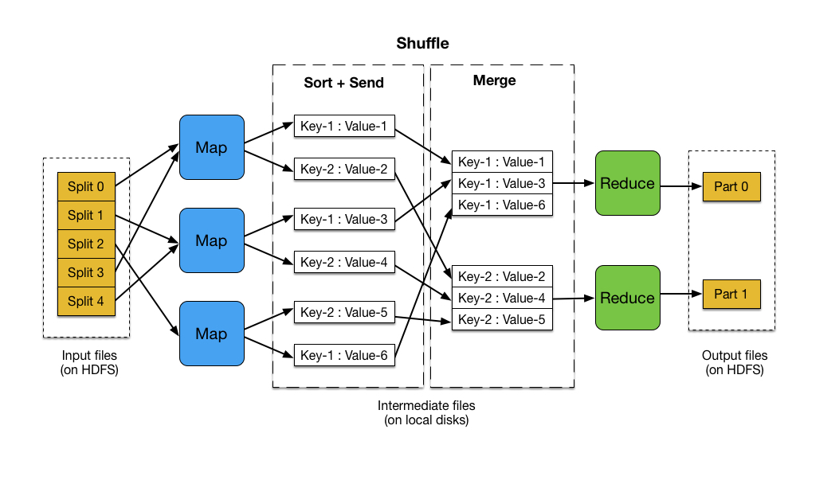
MapReduce
MapReduce works by breaking the processing into two phases: map and reduce. Each phase uses key-value pairs as input and output, the types of which can be chosen by the user.

Slide 25
MapReduce
The input files are split and fed to mappers on different machines. Each mapper processes the corresponding input file "splits" line by line, and outputs the resulting key-value pairs to the local disk.

Slide 26
MapReduce
Hadoop then performs a shuffle operation wherein the key-value data output by the map operations is sorted across machines. This is done to collect the key value data and group it by key so that data with the same key is sent to the same reducer.

Slide 27
MapReduce
The reducers then combines each group of key-value pairs with the same key into a single key-value pair. Since the shuffle phase is carried out automatically by Hadoop, the user only needs to define the map and reduce operations.

Slide 28
Some limitations of Hadoop MapReduce
Slow Processing Speed: In Hadoop, with a parallel and distributed algorithm, the MapReduce process large data sets.
There are tasks that we need to perform: Map and Reduce and, MapReduce requires a lot of time to perform these tasks thereby increasing latency.
Data is distributed and processed over the cluster in MapReduce which increases the time and reduces processing speed.
Only Batch Processing: Hadoop supports batch processing only, it does not process streamed data, and hence overall performance is slower.
The MapReduce framework of Hadoop does not leverage the memory of the Hadoop Cluster to the maximum.
No Real Time Processing: Apache Hadoop is for batch processing, which means it takes a huge amount of data in input, process it and produces the result. Although batch processing is very efficient for processing a high volume of data, depending on the size of the data that processes and the computational power of the system, an output can delay significantly. Hadoop is not suitable for Real-time data processing.

Slide 29
Some limitations of Hadoop MapReduce
Inefficient for iterative processing: Hadoop is not so efficient for iterative processing, as Hadoop does not support cyclic data flow(i.e. a chain of stages in which each output of the previous stage is the input to the next stage).
Latency: In Hadoop, MapReduce framework is comparatively slower, since it is for supporting different format, structure and huge volume of data. In MapReduce, Map takes a set of data and converts it into another set of data, where individual elements are broken down into Key-Value pairs and Reduce takes the output from the map as input and process further and MapReduce requires a lot of time to perform these tasks thereby increasing latency.
No Caching: Hadoop is not efficient for caching. In Hadoop, MapReduce cannot cache the intermediate data in memory for a further requirement which diminishes the performance of Hadoop.

Slide 30
Pinpointing the issue
Acyclic data flow is inefficient for applications that repeatedly reuse a working set of data:
Iterative algorithms (machine learning, graphs)
Interactive data mining tools (R, Excel, Python)
With current frameworks, apps reload data from stable storage on each query

Slide 31
Spark
As a result of Limitations of Hadoop, the need for Spark emerged. Thus made the system more friendly to play with a huge amount of data. Spark provides in-memory processing of data thus improves the processing speed.
In-memory processing is faster as no time is spent in moving the data/processes in and out of the disk. Spark is 100 times faster than MapReduce as it processes everything in memory.
Spark supports stream processing. Stream processing involves continuous input and output of data. It emphasizes on the velocity of the data, and data processes within a small period of time.
Spark iterates its data in batches. For iterative processing in Spark, we schedule and execute each iteration separately.
Spark is yet another batch system but it is relatively faster since it caches much of the input data on memory by RDD(Resilient Distributed Dataset) and keeps intermediate data in memory itself.
Spark has interactive mode so that developers and users alike can have intermediate feedback for queries and other activities.

Slide 32
Motivation behind Spark
Iterative algorithms and interactive data exploration are commonly used in many domains
Traditional MapReduce and classical parallel runtimes cannot solve iterative algorithms efficiently
Hadoop: Repeated data access to HDFS, no optimization to data caching and data transfers
MPI: No natural support of fault tolerance and programming interface is complicated

Slide 33
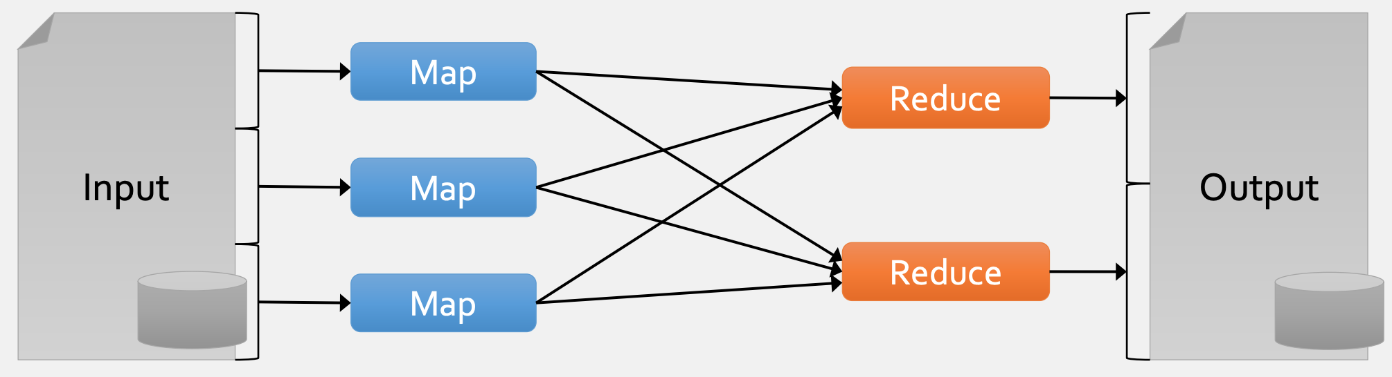
Motivation behind Spark
Most current cluster programming models are based on acyclic data flow from stable storage to stable storage e.g., HDFS to HDFS
Acyclic data flow paradigm is not very efficient for applications that use the same set of data
Iterative algorithms reuse a lot of the data.

Slide 34
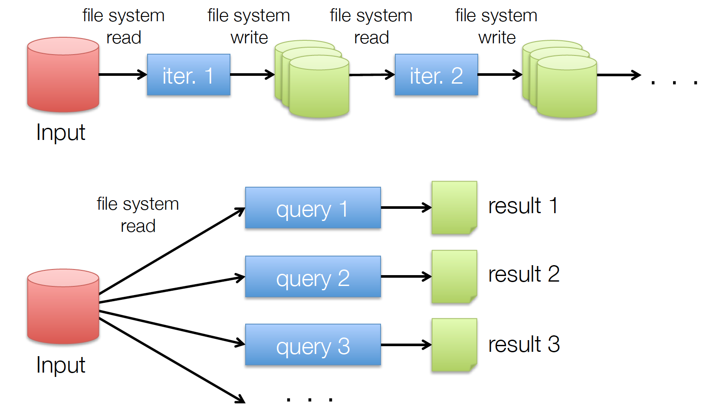
Example of iterative applications
Commonly spend 90% of time during I/O

Slide 35
MapReduce evolved
MapReduce is great at one-pass computation, but inefficient for multi-pass algorithms
No efficient primitives for data sharing
State between steps goes to distributed file system
Slow due to replication & disk storage
Verdict: MapReduce algorithms research doesn’t go to waste, it just gets sped up and easier to use
Still useful to study as an algorithmic framework, silly to use directly

Slide 36
Obvious Solution
Split iteration into multiple MapReduce jobs
Write a driver program for orchestration
You can run Spark using its standalone cluster mode, on EC2, on Hadoop Yarn, on Mesos, or on Kubernetes. Access data in HDFS, Cassandra, HBase, Hive and hundreds of other data sources.
Spark Computing Engine

Slide 37
Apache Spark
Extended the MapReduce model to better support two common classes of analytics
Iterative algorithms (Machine Learning, graphs, database access, interactive search etc.)
Interactive data mining (e.g., load, filter)
Enhance programmability
Integrate into Scala programming language
Allow interactive use from Scala interpreter

Slide 38
Spark
Spark is the cluster computing framework for large-scale data processing.
Spark offers a set of libraries in three languages (Java, Scala, Python) for its unified computing engine.
Unified — with Spark, there is no need to piece together an application out of multiple APIs or systems. Spark provides you with enough built-in APIs to get the job done.
Computing Engine — Spark handles the loading of data from various file systems and runs computations on it, but does not store any data itself permanently. Spark operates entirely in memory, allowing unparalleled performance and speed.
Libraries — Spark is comprised of a series of libraries built for data science tasks. Spark includes libraries for SQL (Spark SQL), Machine Learning (MLlib), Stream Processing (Spark Streaming and Structured Streaming), and Graph Analytics (GraphX).

Slide 39
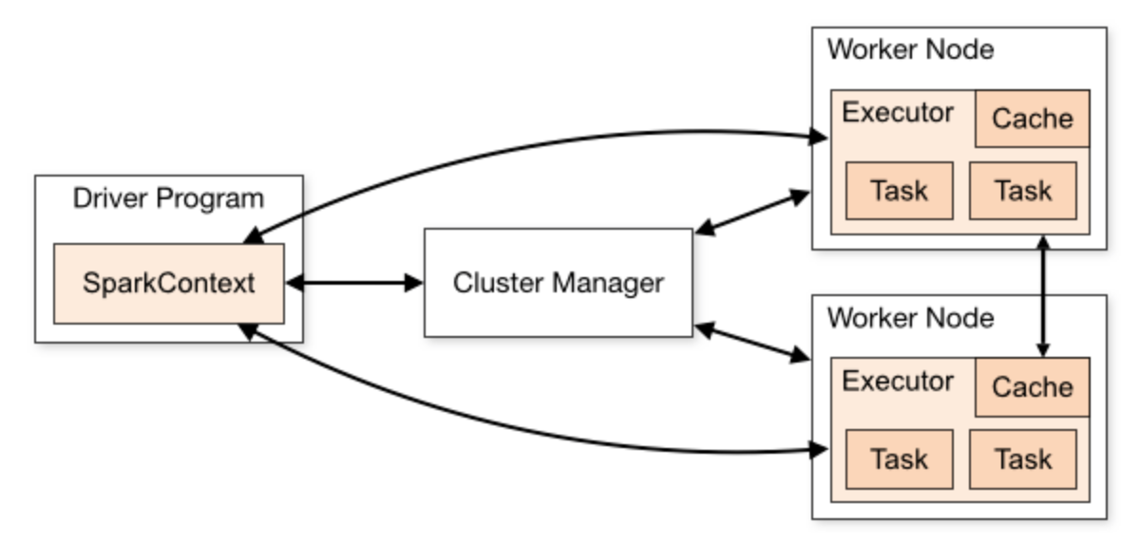
Main Components
Every Spark application consists of a Driver and a set of distributed worker processes (Executors)

Slide 40
Driver Program – SparkContext
Spark applications run as independent sets of processes on a cluster, coordinated by the SparkContext object in the main program (called the driver program).

Slide 41
Driver Program
The driver program must listen for and accept incoming connections from its executors throughout its lifetime. As such, the driver program must be network addressable from the worker nodes.
Because the driver schedules tasks on the cluster, it should be run close to the worker nodes, preferably on the same local area network. If you’d like to send requests to the cluster remotely, it’s better to open an RPC to the driver and have it submit operations from nearby than to run a driver far away from the worker nodes.

Slide 42
Cluster Manager
Specifically, to run on a cluster, the SparkContext can connect to several types of Cluster Managers (either Spark’s own standalone cluster manager, Mesos or YARN), which allocate resources across applications.

Slide 43
Worker Node - Executor
Once connected, Spark acquires Executors on nodes in the cluster, which are processes that run computations and store data for your application. Next, it sends your application code (defined by JAR or Python files passed to SparkContext) to the executors. Finally, SparkContext sends tasks to the executors to run.

Slide 44
SparkContext→ClusterManager→ Executor
Each application gets its own executor processes, which stay up for the duration of the whole application and run tasks in multiple threads.
This has the benefit of isolating applications from each other, on both the scheduling side (each driver schedules its own tasks) and executor side (tasks from different applications run in different JVMs).
However, it also means that data cannot be shared across different Spark applications (instances of SparkContext) without writing it to an external storage system.

Slide 45
Main abstraction in Spark
The main abstraction Spark provides is a resilient distributed dataset (RDD), which is a collection of elements partitioned across the nodes of the cluster that can be operated on in parallel.
RDDs are created by starting with a file in the Hadoop file system (or any other Hadoop-supported file system), or an existing Scala collection in the driver program, and transforming it.
Users may also ask Spark to persist an RDD in memory, allowing it to be reused efficiently across parallel operations.
Finally, RDDs automatically recover from node failures.

Slide 46
Important points - RDD
Allow apps to keep working sets in memory for efficient reuse
Retain the attractive properties of MapReduce
Fault tolerance, data locality, scalability
Support a wide range of applications

Slide 47
Second abstraction in Spark
A second abstraction in Spark is shared variables that can be used in parallel operations.
By default, when Spark runs a function in parallel as a set of tasks on different nodes, it ships a copy of each variable used in the function to each task.
Sometimes, a variable needs to be shared across tasks, or between tasks and the driver program.
Spark supports two types of shared variables: broadcast variables, which can be used to cache a value in memory on all nodes, and accumulators, which are variables that are only “added” to, such as counters and sums.

Slide 48
Example: Log Mining Algorithm
Applications: Many applications in Enterprise and IT e.g., Network log, Message log, Transaction log, Server log, System log etc.
Problem description: Suppose you have a huge amount of logs, and you want to load them into memory and find the log messages that contain an error.
Approach: Find the log messages that contain a string “error”, and then interactively search for a couple of different patterns within these errors.
So let's see how we can do this in a very nice fashion in Spark.

Slide 49


Example: Log Mining Algorithm
So of course, we have a cluster.
We have a lot of worker machines, and say a driver machine that is orchestrating everything.

Slide 50
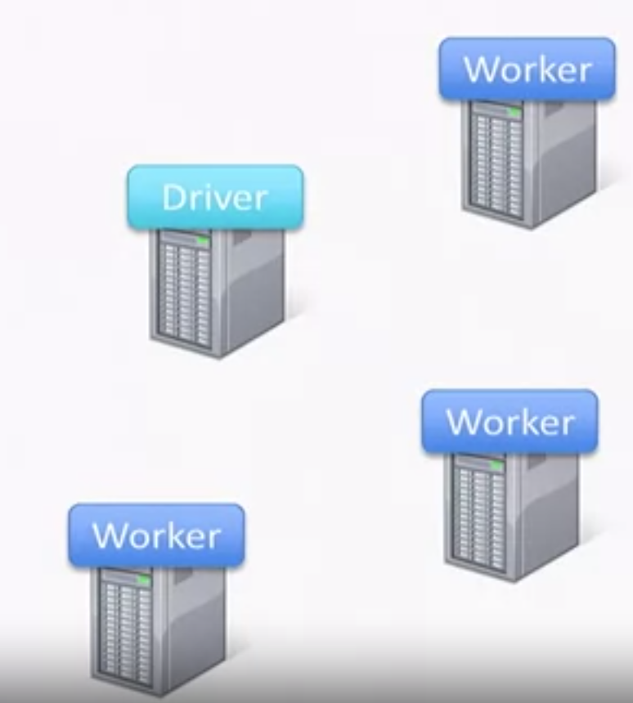
Example: Log Mining Algorithm
Step 1: Loading the data stored on hard drives into one RDD i.e., loading it from hard drives into memory, distributed across the cluster.
lines = spark.textfile(“hdfs://…” )
Base RDD
Loaded all the log lines in memory distributed across the cluster.
So, lines RDD here is the base RDD. Next processing can be build
on top of that.

Slide 51
Example: Log Mining Algorithm
Step 2: Find the lines that say “ERROR”.
So we can say RDD called errors, which is derived from previous RDD lines
lines = spark.textfile(“hdfs://…” )
errors = lines.filter(_.startswith(“ERROR”))
Base RDD
Transformed RDD
Spark uses Scala, and Scala is a functional programming language. So it allows you to write in line functions, very nice semantics.
filter(func): Return a new dataset formed by selecting those elements of the source on which func returns true.

Slide 52
Builder programming pattern
Spark uses the builder programming pattern.
rdd2 = lines.filter.join.anothercomputation.anothercomputation
Builder pattern ensures that these are all running on one after another on the same RDD being lines.

Slide 53
Example: Log Mining Algorithm
Step 3: Lets do some interesting data exploration on our transformed RDD i.e., errors. Take every single element of them and split the whole string based on the tab
character, /t, into two different parts.
lines = spark.textfile(“hdfs://…” )
errors = lines.filter(_.startswith(“ERROR”))
messages = errors.map(_.split(‘\t’)(2))
Base RDD
Transformed RDD
map(func): Return a new distributed dataset formed by passing each element of the source through a function func.

Slide 54
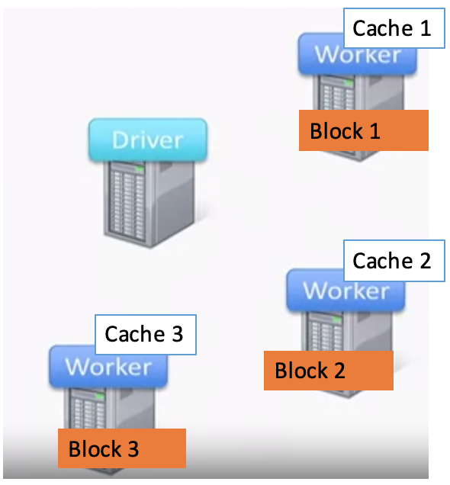
Example: Log Mining Algorithm
Step 4: Lets do caching on RDD. Instruct the framework to not optimize things, in other words, do not remove cache messages from memory when it's looking for memory, and it will remain in memory.
lines = spark.textfile(“hdfs://…” )
errors = lines.filter(_.startswith(“ERROR”))
messages = errors.map(_.split(‘\t’)(2))
cachedMsgs = messages.cache()
Base RDD
Transformed RDD
We can mark an RDD to be persisted using the persist() or cache() methods on it. Spark’s cache is fault-tolerant – if any partition of an RDD is lost, it will automatically be recomputed using the transformations that originally created it.

Slide 55
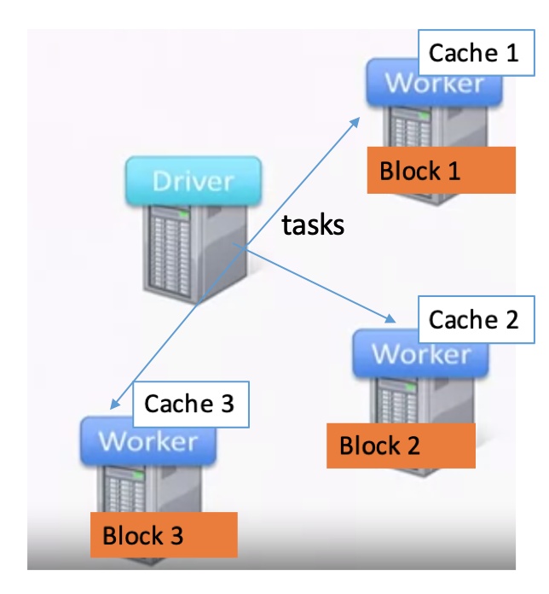
Example: Log Mining Algorithm
Step 5: find lines that contain the string “connection” and then, under the result of this filter, run the count command.
lines = spark.textfile(“hdfs://…” )
errors = lines.filter(_.startswith(“ERROR”))
messages = errors.map(_.split(‘\t’)(2))
cachedMsgs = messages.cache()
cachedMsgs.filter(_.contains(“connection”)).count
Base RDD
Transformed RDD
When there is an action, Spark distributes that computation across the cluster and do all these transformations and the action all together in the different machines

Slide 56
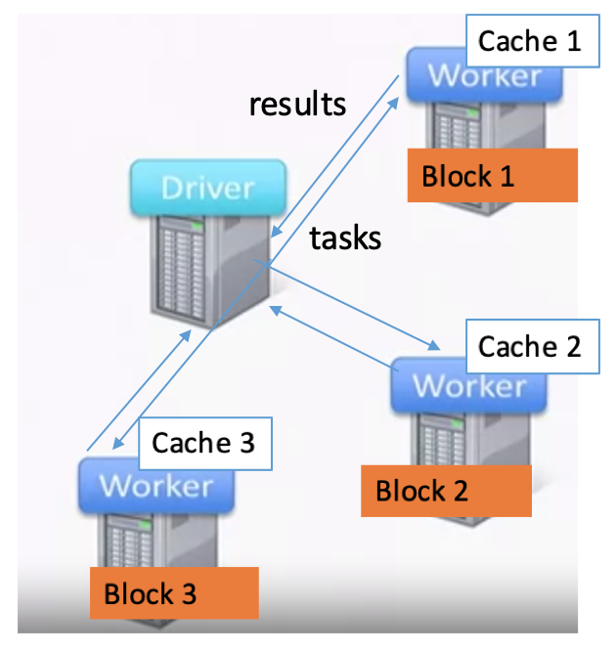
Example: Log Mining Algorithm
Step 5: find lines that contain the string “connection” and then, under the result of this filter, run the count command.
lines = spark.textfile(“hdfs://…” )
errors = lines.filter(_.startswith(“ERROR”))
messages = errors.map(_.split(‘\t’)(2))
cachedMsgs = messages.cache()
cachedMsgs.filter(_.contains(“connection”)).count
Base RDD
Transformed RDD
count: Return the number of elements in the dataset.
Each worker machine does the computation and returns the results to the driver machine.

Slide 57
Example: Log Mining Algorithm
Step 6: Apply different filtering option. For example, find lines that contain the string “dns” and then, under the result of this filter, run the count command.
lines = spark.textfile(“hdfs://…” )
errors = lines.filter(_.startswith(“ERROR”))
messages = errors.map(_.split(‘\t’)(2))
cachedMsgs = messages.cache()
cachedMsgs.filter(_.contains(“connection”)).count
cachedMsgs.filter(_.contains(“dns”)).count
Base RDD
Transformed RDD
Each worker works on the cached items and sends the results back

Slide 58
Example: Log Mining Algorithm
Step 7 : Apply different filtering option. For example, find lines that contain the string “timeout” and then, under the result of this filter, run the count command.
lines = spark.textfile(“hdfs://…” )
errors = lines.filter(_.startswith(“ERROR”))
messages = errors.map(_.split(‘\t’)(2))
cachedMsgs = messages.cache()
cachedMsgs.filter(_.contains(“connection”)).count
cachedMsgs.filter(_.contains(“dns”)).count
cachedMsgs.filter(_.contains(“timeout”)).count
Base RDD
Transformed RDD
Each worker works on the cached items and sends the results back

Slide 59
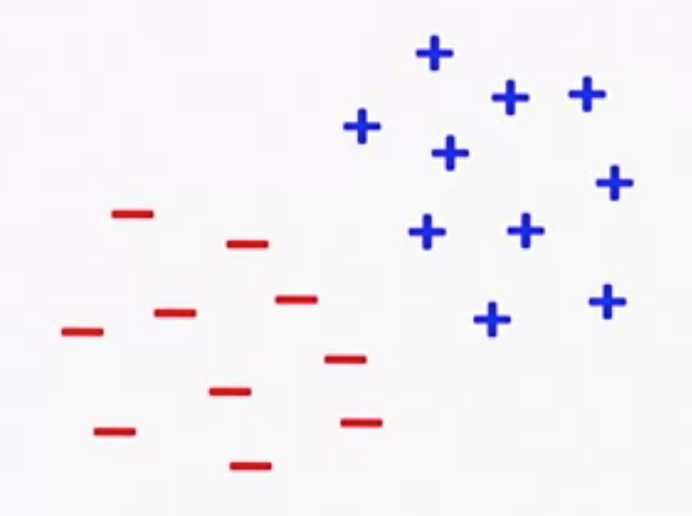
Example: Logistic Regression
Goal: Find the best line separating two sets of points

Slide 60
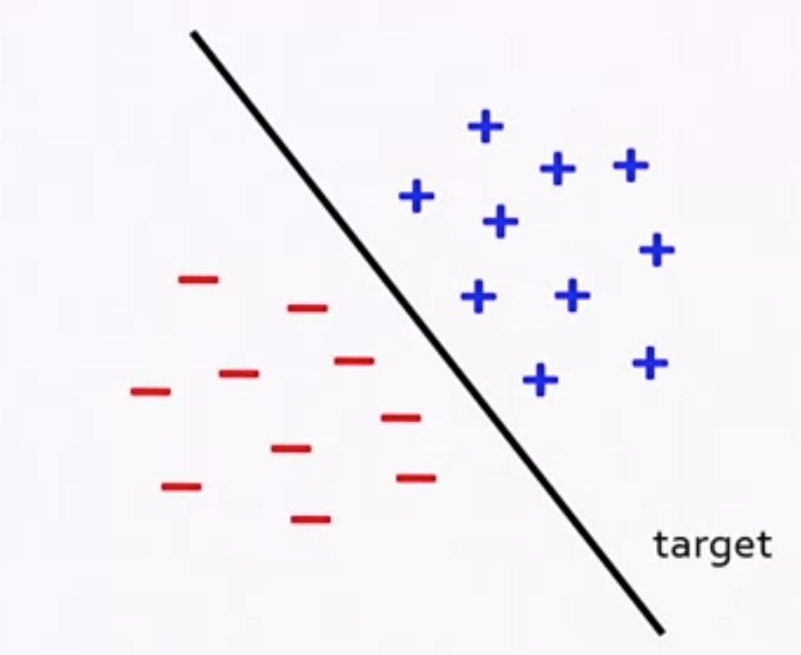
Example: Logistic Regression
Goal: Find the best line separating two sets of points

Slide 61
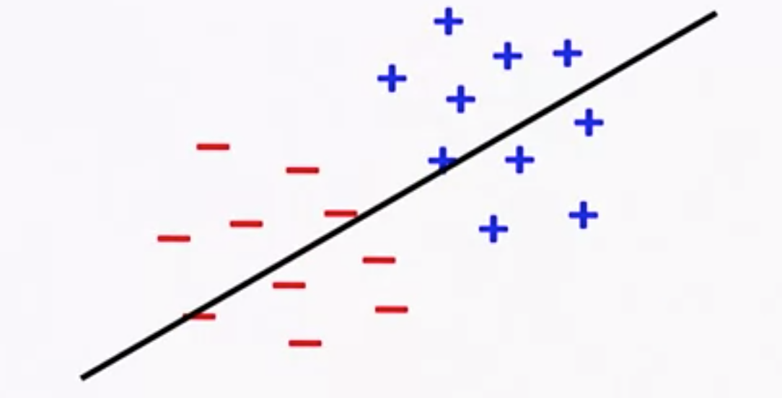
Example: Logistic Regression
Goal: Find the best line separating two sets of points
Initial Random target line

Slide 62
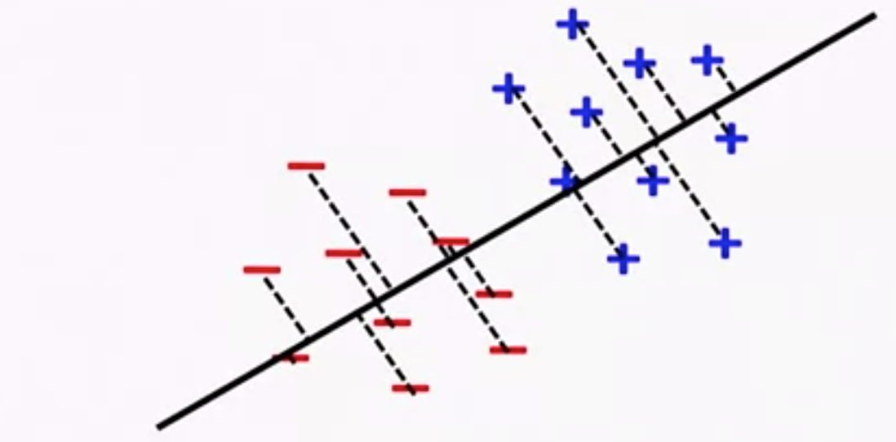
Example: Logistic Regression
Goal: Find the best line separating two sets of points

Slide 63
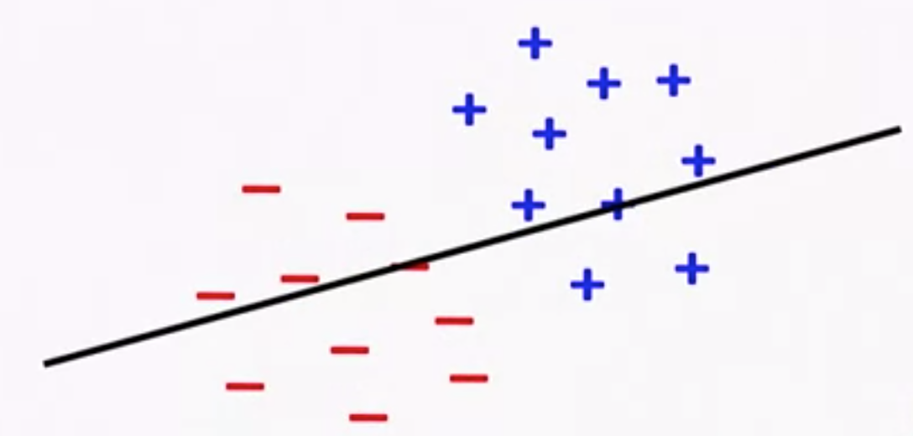
Example: Logistic Regression
Goal: Find the best line separating two sets of points

Slide 64
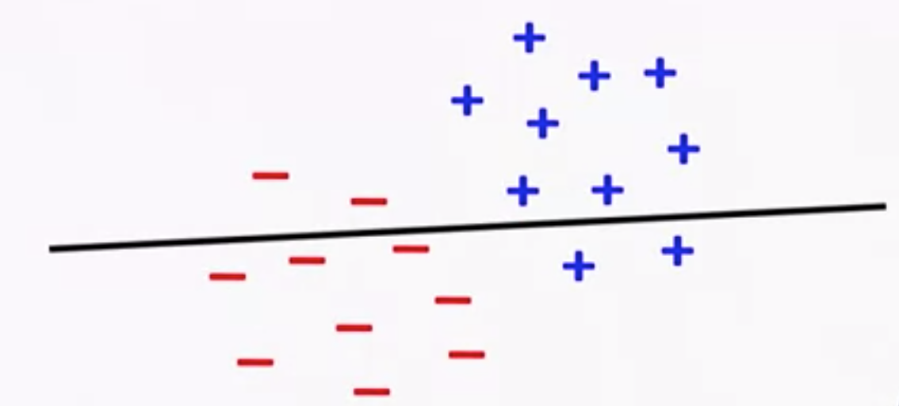
Example: Logistic Regression
Goal: Find the best line separating two sets of points

Slide 65
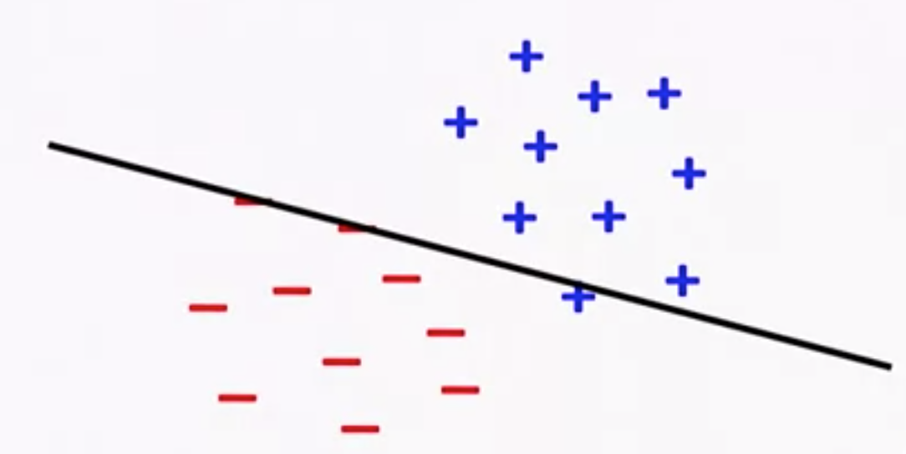
Example: Logistic Regression
Goal: Find the best line separating two sets of points

Slide 66
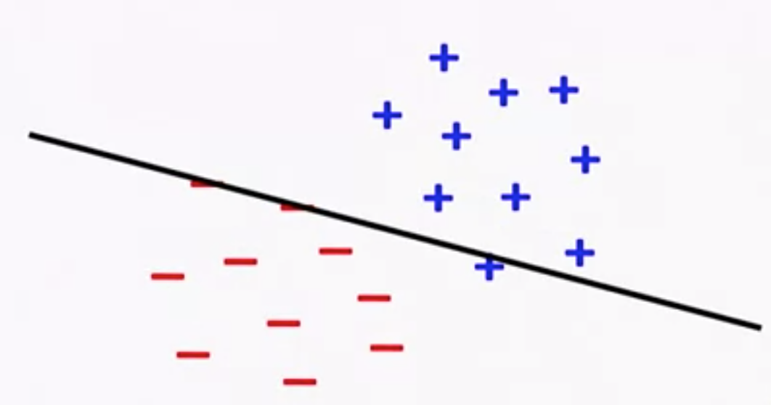
Example: Logistic Regression
Goal: Find the best line separating two sets of points

Slide 67
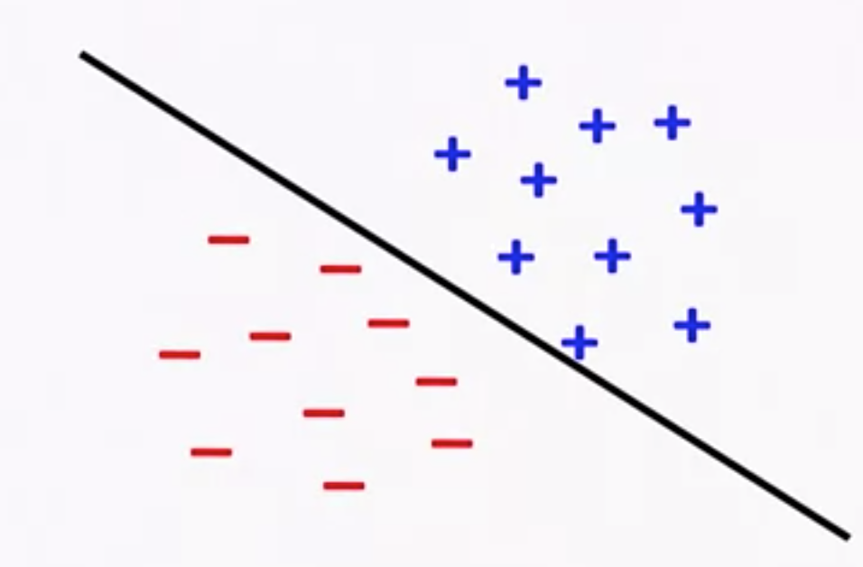
Example: Logistic Regression
Goal: Find the best line separating two sets of points

Slide 68
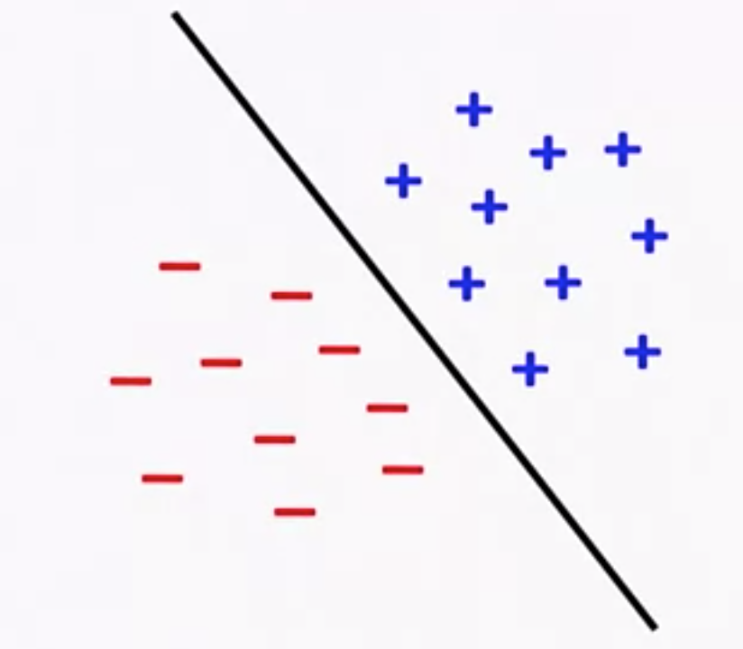
Example: Logistic Regression
Goal: Find the best line separating two sets of points

Slide 69
Example: Logistic Regression
val data = spark.textfile(…).map(readPoint).cache
var w = vector.random(D)
for (i <- 1 to ITERATIONS) {
val gradient = data.map(p=>
(1/(1+exp(-p.y*(w dot p.x))) -1)*p.y*p.x).reduce(_+_)
w -= gradient
}
println(“final w: ” + w)
https://spark.apache.org/docs/latest/mllib-linear-methods.html

Slide 70
Spark MLlib
Spark’s machine learning (ML) library
Ease of use
Scalable
Collection of ML libraries
Classification and Regression
Linear models (SVMs, logistic regression, linear regression), naive Bayes, decision trees, ensembles of trees (Random Forests and Gradient-Boosted Trees)
Clustering
k-means, Gaussian mixture, power iteration clustering (PIC), latent Dirichlet allocation (LDA), streaming k-means
Dimensionality Reduction
Singular Value Decomposition (SVD), Principal Component Analysis (PCA)

Slide 71
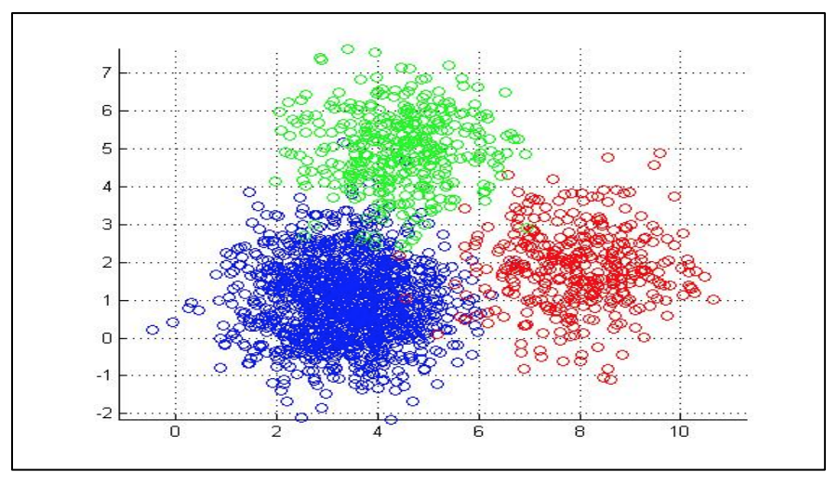
Example: K-Means Clustering in MapReduce
Input
– Dataset (set of points in 2D) --Large
– Initial centroids (K points) --Small
Map Side
– Each map reads the K-centroids + one block from dataset
– Assign each point to the closest centroid
– Output
Reduce Side
– Gets all points for a given centroid
– Re-compute a new centroid for this cluster
– Output: <new centroid>
Iteration Control
– Compare the old and new set of K-centroids
If similar → Stop
Else If max iterations has reached → Stop
Else → Start another Map-Reduce Iteration

Slide 72
Example: K-Means Clustering in Spark
import org.apache.spark.mllib.clustering.{KMeans, KMeansModel}
import org.apache.spark.mllib.linalg.Vectors
// Load and parse the data
val data = sc.textFile("data/mllib/kmeans_data.txt")
val parsedData = data.map(s => Vectors.dense(s.split('').map(_.toDouble))).cache()
// Cluster the data into three classes using KMeans
val numClusters = 3
val numIterations = 20
val clusters = KMeans.train(parsedData, numClusters, numIterations)
// Evaluate clustering by computing Within Set Sum of Squared Errors
val WSSSE = clusters.computeCost(parsedData)
println("Within Set Sum of Squared Errors = " + WSSSE)
// Save and load model
clusters.save(sc, "myModelPath")
val sameModel = KMeansModel.load(sc, "myModelPath")

Slide 73
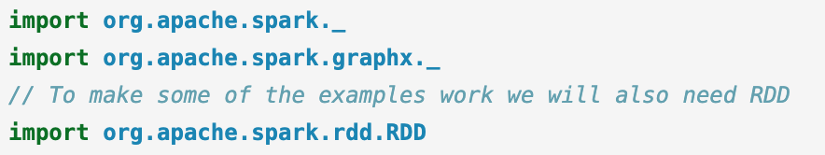
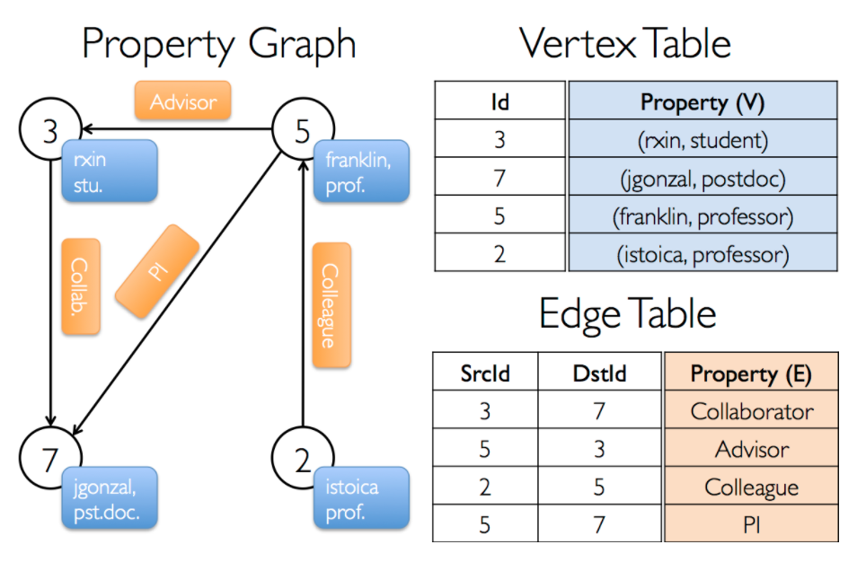
GraphX
GraphX is a new component in Spark for graphs and graph-parallel computation. At a high level, GraphX extends the Spark RDD by introducing a new Graph abstraction: a directed multigraph with properties attached to each vertex and edge.

Slide 74
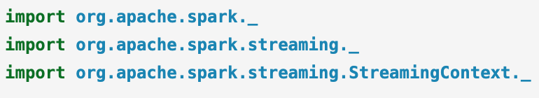
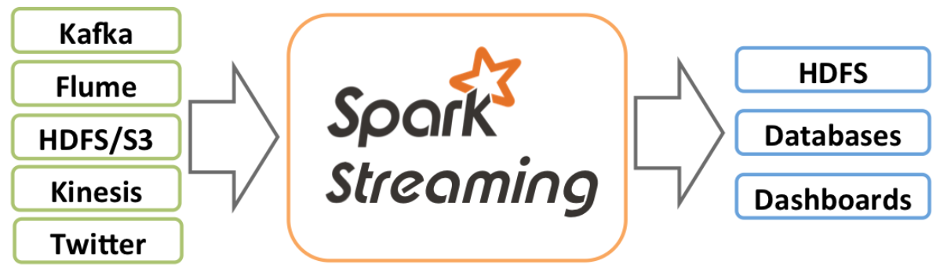
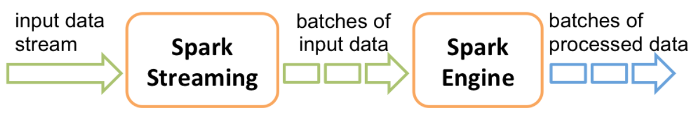
Spark Streaming
Spark Streaming is an extension of the core Spark API that enables scalable, high-throughput, fault-tolerant stream processing of live data streams.
Data can be ingested from many sources like Kafka, Kinesis, or TCP sockets, and can be processed using complex algorithms expressed with high-level functions like map, reduce etc.
Finally, processed data can be pushed out to filesystems, databases, and live dashboards.

Slide 75
References
https://spark.apache.org/docs/latest/rdd-programming-guide.html
https://spark.apache.org/docs/latest/mllib-linear-methods.html#implementation-developer
https://spark.apache.org/docs/latest/graphx-programming-guide.html
https://spark.apache.org/docs/latest/streaming-programming-guide.html
Coursera course on Cloud Computing Applications, Part 2: Big Data and Applications in the Cloud, https://www.coursera.org/learn/cloud-applications-part2/home/welcome

